Slide 1

Coffee Shop
The „Coffee Shop“ Challenge

Slide 2
The approach
The customer and the barista have different needs for the system based on their user stories
Specify functional requirements based on the users for the coffee shop website
Identify the requirements and implement the core features of the website

Slide 3
The approach
Break the features down into issues

Slide 4
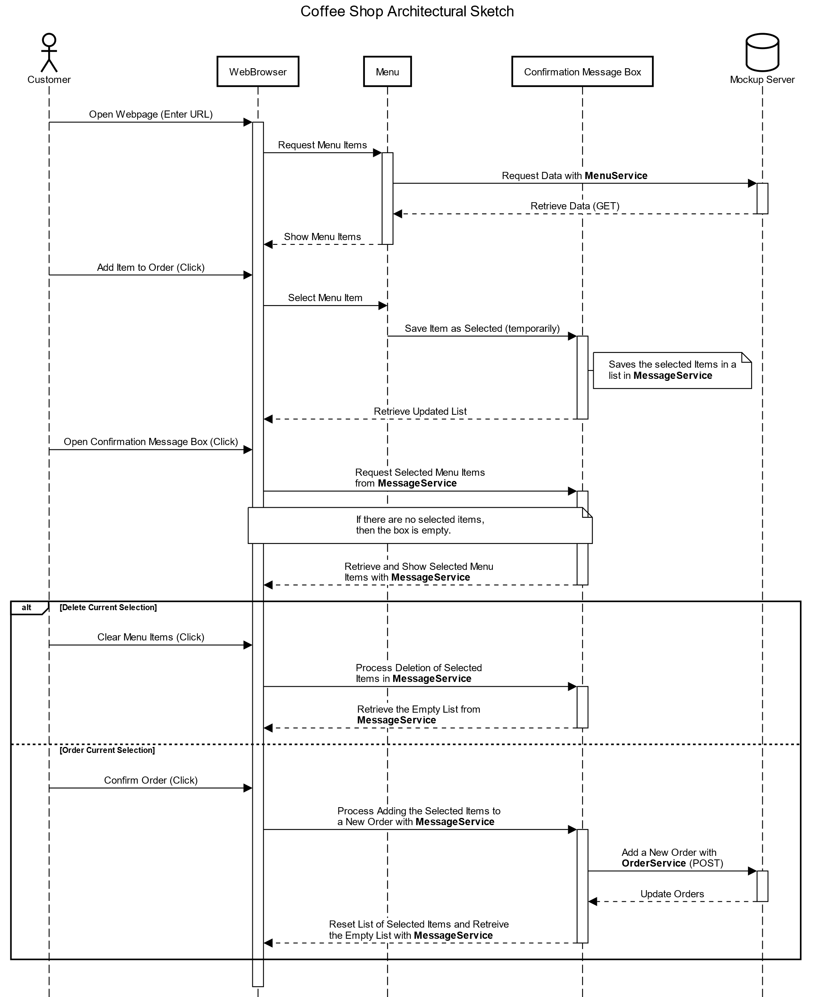
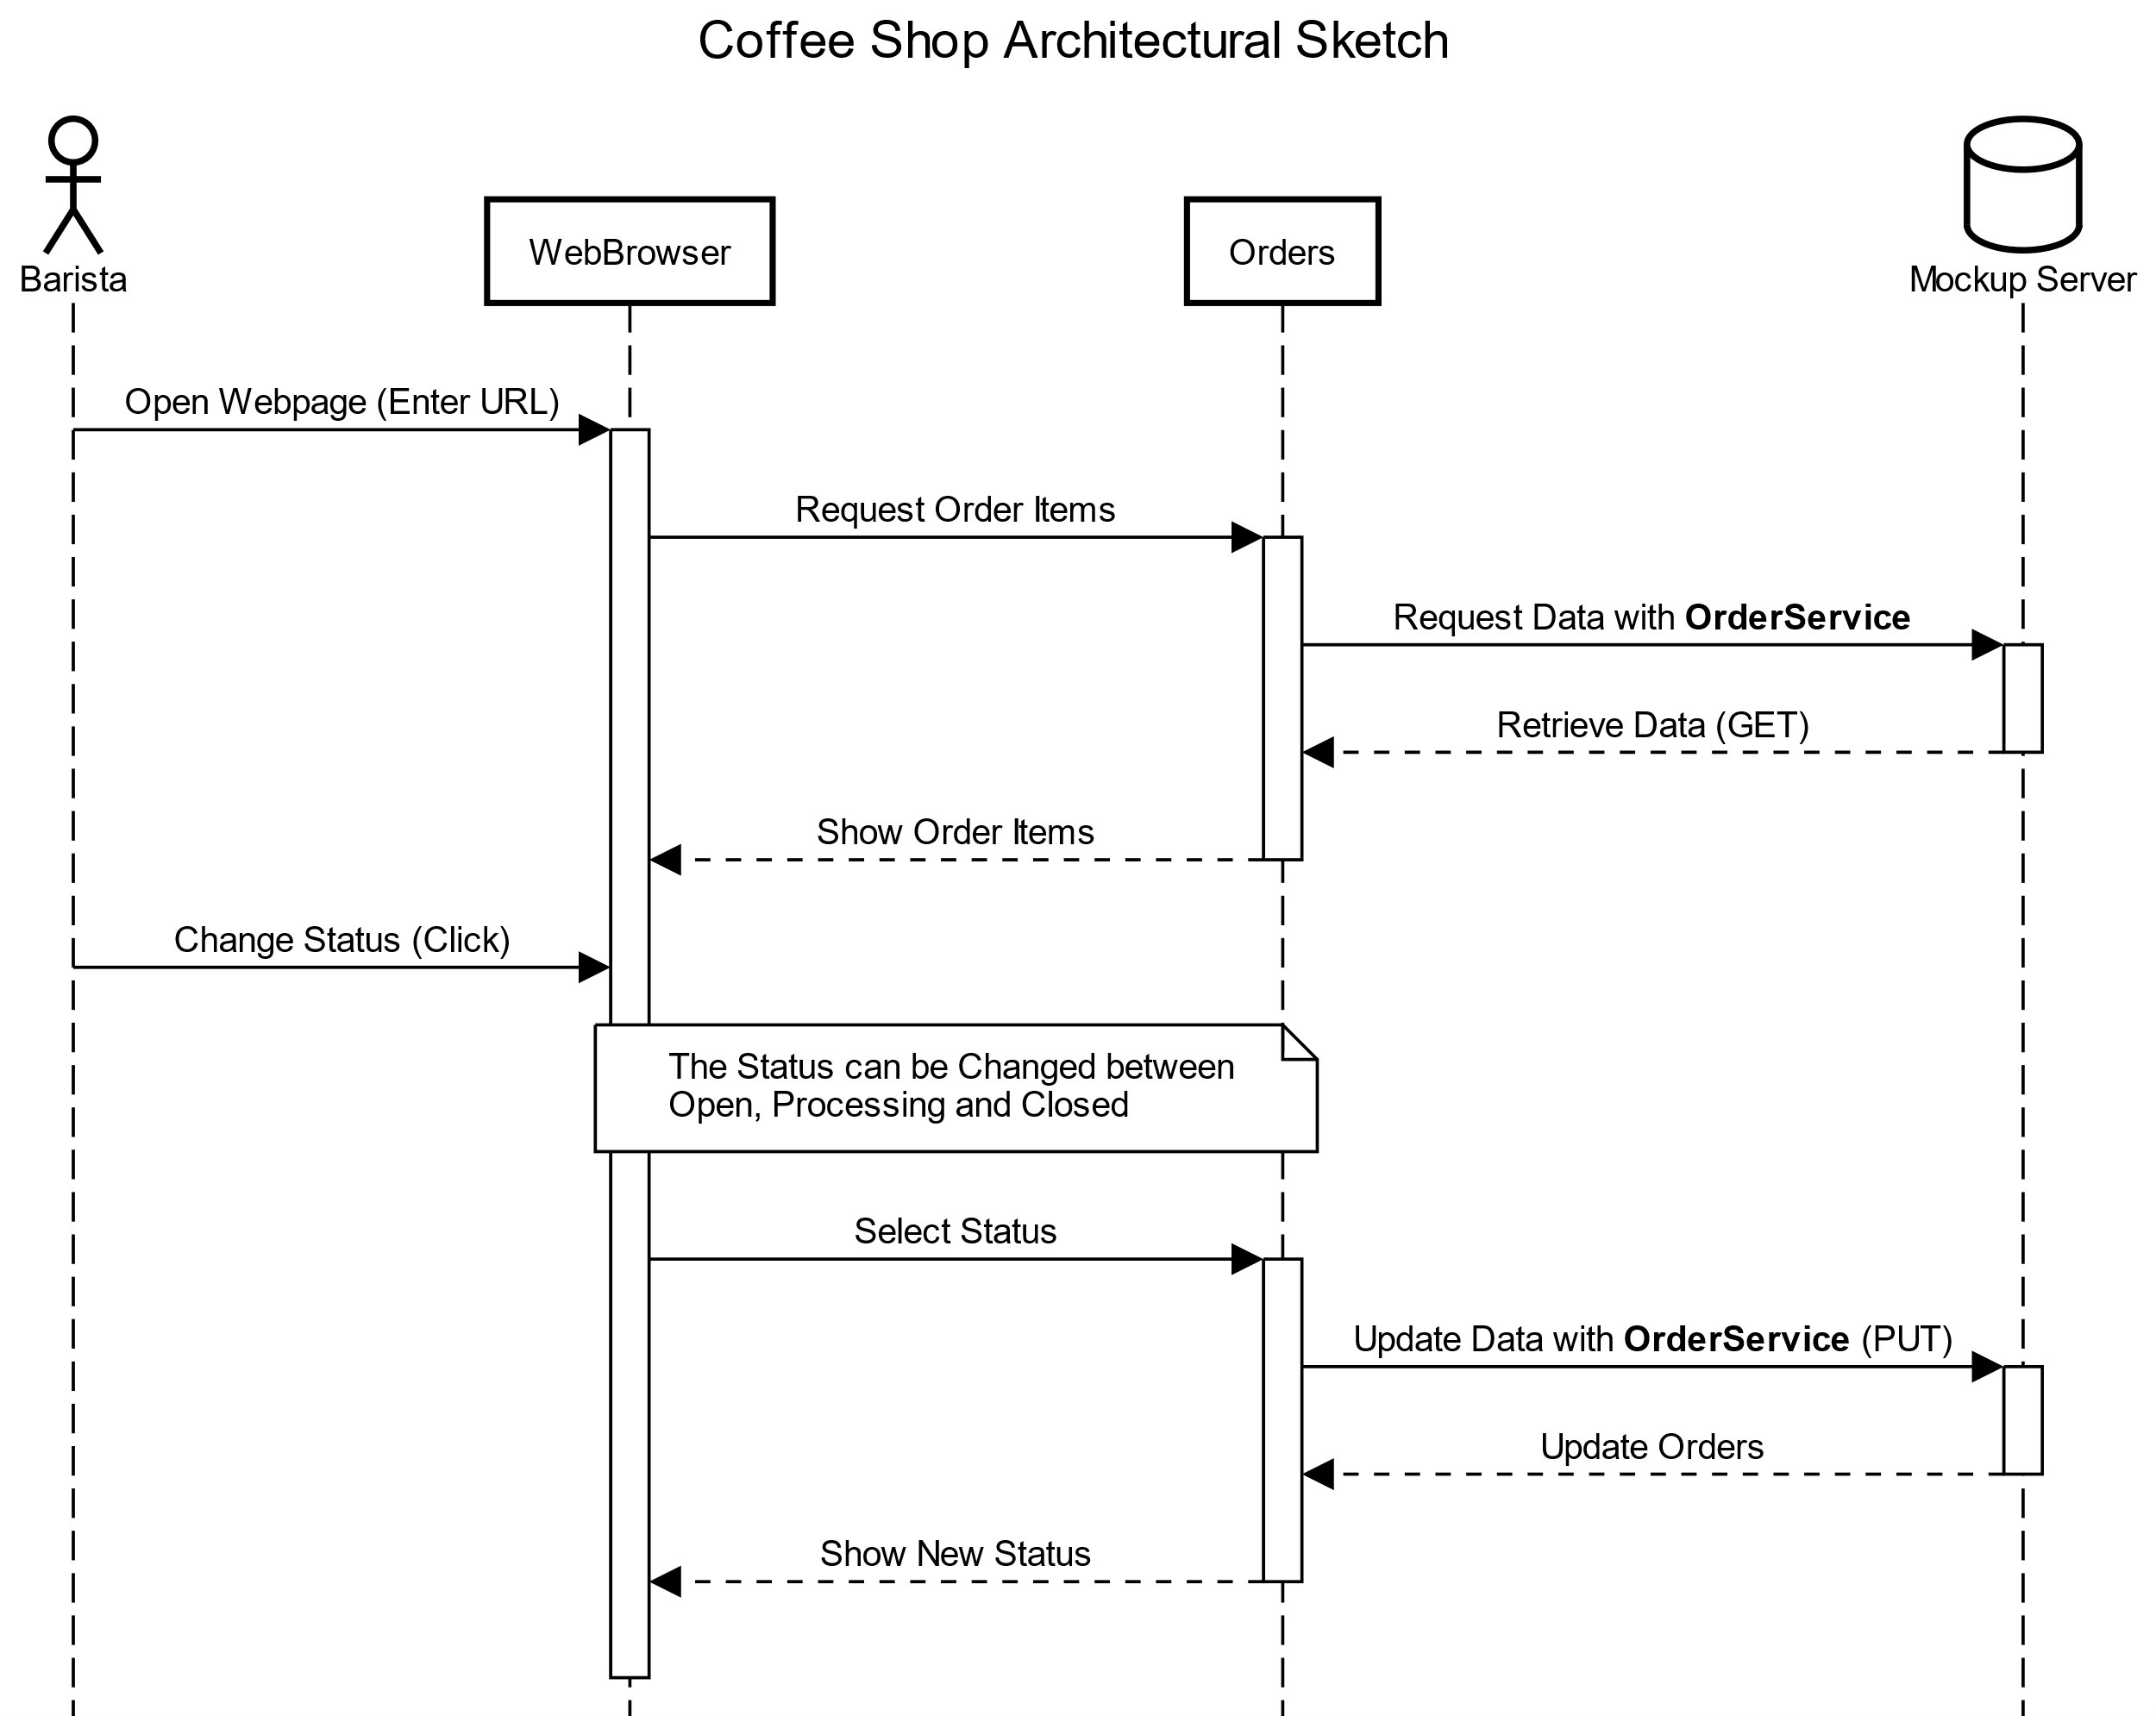
Architectural Sketches

Slide 5
The app
Components: Menu, Orders, Messages
Services: MenuService, OrderService, MessageService
Interface: MenuItem, OrderItem
Mock-Server: InMemoryDataService

Slide 6
Menu Display (Customer)

Slide 7
Orders Display (Barista)

Slide 8
Demo
Public GitHub Repository: https://github.com/KevinA1224/CoffeeShop

